Slide 1
Homework Unit 5
Ran Cheng 27720161153019
WISE Master of Finance

Slide 2
Q1. do a word cloud for Shakesspeare’s dramas. Romeo and Julia, Julius Caesar, Hamlet.
#install.packages("bitops")
#install.packages("stringr")
library(bitops)
library(stringr)
abs1 = lapply(url1, FUN = function(x) htmlParse(x, encoding = "Latin-1"))
abs2 = lapply(url2, FUN = function(x) htmlParse(x, encoding = "Latin-1"))
abs3 = lapply(url3, FUN = function(x) htmlParse(x, encoding = "Latin-1"))
clean_txt = function(x) {
cleantxt = xpathApply(x, "//body//text()
[not(ancestor :: script)][ not(ancestor :: style)]
[not(ancestor :: noscript)] " ,xmlValue)
cleantxt = paste(cleantxt, collapse="\n")
cleantxt = str_replace_all(cleantxt, "\n", " ")
cleantxt = str_replace_all(cleantxt, "\r", "")
cleantxt = str_replace_all(cleantxt, "\t", "")
cleantxt = str_replace_all(cleantxt, "<br>", "")
return(cleantxt)
}
rm(list = ls())
#install.packages("RCurl")
#install.packages("XML")
library(RCurl)
library(XML)
url1 = "http://shakespeare.mit.edu/romeo_juliet/full.html"
url2 = "http://shakespeare.mit.edu/julius_caesar/full.html"
url3 = "http://shakespeare.mit.edu/hamlet/full.html"
html1 = readLines(url1, encoding = "UTF-8")
html2 = readLines(url2, encoding = "UTF-8")
html3 = readLines(url3, encoding = "UTF-8")
html1 = htmlParse(html1, encoding = "UTF-8")
html2 = htmlParse(html2, encoding = "UTF-8")
html3 = htmlParse(html3, encoding = "UTF-8")

Slide 3
removeNumbers = TRUE, removePunctuation = TRUE))
abs_dtm2 = DocumentTermMatrix(abs2, control = list(
stemming = TRUE, stopwords = TRUE, minWordLength = 3,
removeNumbers = TRUE, removePunctuation = TRUE))
abs_dtm3 = DocumentTermMatrix(abs3, control = list(
stemming = TRUE, stopwords = TRUE, minWordLength = 3,
removeNumbers = TRUE, removePunctuation = TRUE))
##WordCloud
instal.packages("ggplot2")
install.packages("wordcloud")
library(ggplot2)
library(wordcloud)
freq1 = colSums(as.matrix(abs_dtm1))
freq2 = colSums(as.matrix(abs_dtm2))
freq3 = colSums(as.matrix(abs_dtm3))
wf1 = data.frame(word=names(freq1), freq=freq1)
wf2 = data.frame(word=names(freq2), freq=freq2)
wf3 = data.frame(word=names(freq3), freq=freq3)
cleantxt1 = lapply(abs1,clean_txt)
cleantxt2 = lapply(abs2,clean_txt)
cleantxt3 = lapply(abs3,clean_txt)
vec_abs1 = unlist(cleantxt1)
vec_abs2 = unlist(cleantxt2)
vec_abs3 = unlist(cleantxt3)
#install.packages("tm")
#install.packages("SnowballC")
library(tm)
library(SnowballC)
abs1 = Corpus(VectorSource(vec_abs1))
abs2 = Corpus(VectorSource(vec_abs2))
abs3 = Corpus(VectorSource(vec_abs3))
abs_dtm1 = DocumentTermMatrix(abs1, control = list(
stemming = TRUE, stopwords = TRUE, minWordLength = 3,

Slide 4
#Romeo and Juliet
plot1 = ggplot(subset(wf1, freq>15), aes(word, freq1))
plot1 = plot1 + geom_bar(stat="identity")
plot1 = plot1 + theme(axis.text.x=element_text(angle=45, hjust=1))
plot1
freq1 = colSums(as.matrix(abs_dtm1))
dark2_1 = brewer.pal(6, "Dark2")
wordcloud(names(freq1), freq1, max.words=100, rot.per=0.2, colors=dark2_1)
#Julius Caeser
plot2 = ggplot(subset(wf2, freq>15), aes(word, freq2))
plot2 = plot2 + geom_bar(stat="identity")
plot2 = plot2 + theme(axis.text.x=element_text(angle=45, hjust=1))
plot2
freq2 = colSums(as.matrix(abs_dtm2))
dark2_2 = brewer.pal(6, "Dark2")
wordcloud(names(freq2), freq2, max.words=100, rot.per=0.2, colors=dark2_2)
#Hamlet
plot3 = ggplot(subset(wf3, freq>15), aes(word, freq3))
plot3 = plot3 + geom_bar(stat="identity")
plot3 = plot3 + theme(axis.text.x=element_text(angle=45, hjust=1))
plot3
freq3 = colSums(as.matrix(abs_dtm3))
dark2_3 = brewer.pal(6, "Dark2")
wordcloud(names(freq3), freq3, max.words=100, rot.per=0.2, colors=dark2_3)

Slide 5
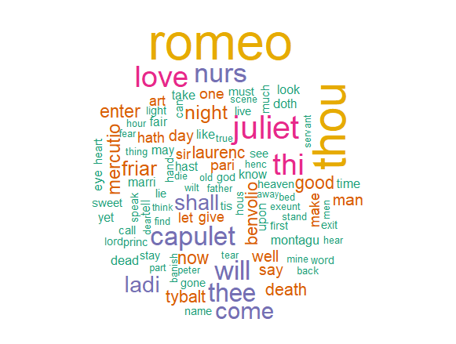
Figure 1: Romeo and Julia

Slide 6
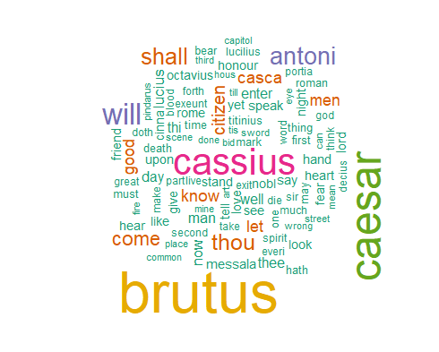
Figure 2: Julius Caesar

Slide 7
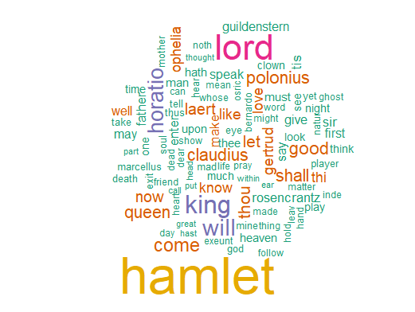
Figure 3: Hamlet

Slide 8
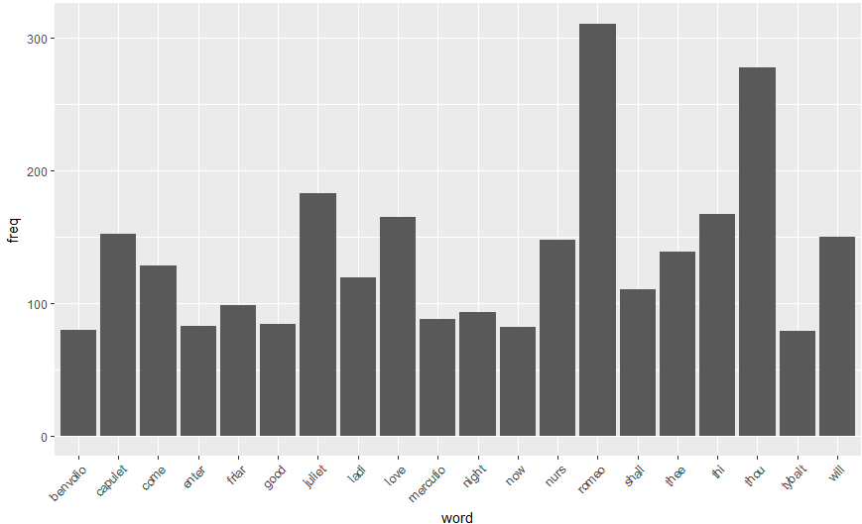
Q2. calculate the histogram of words
Figure 4: Romeo and Julia

Slide 9
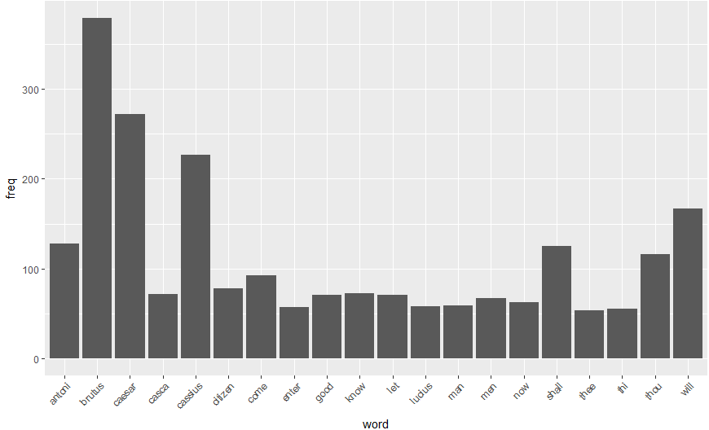
Figure 5: Julius Caesar

Slide 10
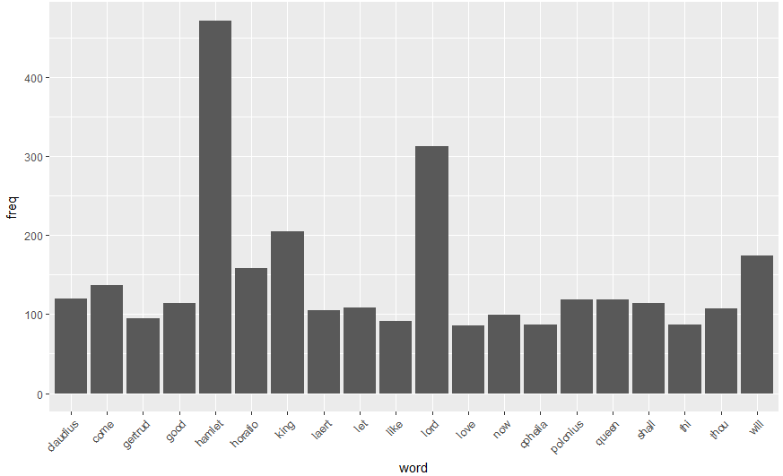
Figure 6: Hamlet

Slide 11
Thank you

